Slide 1



Bank of Baroda Hackathon - 2022
Technology Partner
Team Name :
HEURISTIC SOLARIS
Our Team-bio : Heuristic Solaris is a team of four young minds, working to solve public issues through software programs !
20th September, 2022.

Slide 2
THE REASON FOR CHOOSING THIS PROBLEM STATEMENT:
Very often people come to banks to meet their financial needs, during which they face many problems.
This may put a bad impression on that particular bank.
With the help of analyzing the surveillance footages, it would be easier for the banks to provide better customer service.
This would benefit both the bank and the customers.
Thus our motive is to achieve this solution using the easiest methods possible and with the utmost accuracy.

Slide 3
USER SEGMENTS & PAIN POINTS
The advertiser (Bank of Baroda) would be the early adopter of our model.
Our project would also be helpful to all sectors that is in need of 24*7 CCTV surveillance.
If a person tries to exploit the bank in a way that is not predefined ,the model might fail to send the alert message.
If the exploiter uses a weapon that is new to the database of our model it may fail to recognize the weapon, which might be a major vulnerability.

Slide 4
PRE REQUISITES:
Many video analytics companies have already provided the solution to the problem.
Some of the products that are competitive to our model are being offered by :
Oddetect - *costly
Oxagile - *tendency to be exclusive in business
Briefcam- *low accuracy

Slide 5
AZURE TOOLS & RESOURCES:
At the initial stage , we are planning to train our model using Machine Learning Algorithms(MLA) along with the help of Jupyter Notebook (a notebook environment to train model).
We are planning to use Microsoft Azure Machine Learning Studio to deploy our Machine Learning model trained using Jupyter Notebook.

Slide 6
GENERAL WORKING OF THE MODEL
||||||||||
||||||||||
PROPOSED
MODEL
||||||||||
||||||||||
||||||||||
||||||||||
IMAGE DATASET
FRAMES
FRAMES
LIVE
!
RT ALERT

Slide 7
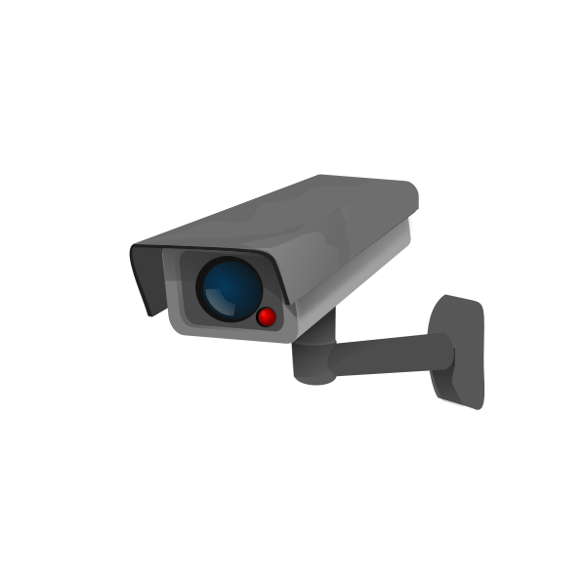
DETAILED ARCHITECTURE OF THE MODEL
IMAGE FRAMES
EVERY 1 MIN
EXCEL SHEET
( ENTRY & EXIT COUNT )
ENTRY AND EXIT CAM
PROPOSED MODEL
PROCESSED DATA
IMAGE FRAMES
ANALYSING CAM
IMAGE DATA SET
MODEL TRAIN
SATISFIED
SUSPICIOUS ACTIVITIES OR WEAPON
PROCESSED IMAGE
SENTIMENT ANALYSIS
EXCEL SHEET
NOT
SATISFIED
BREACH ALERT

Slide 8
KEY DIFFERENTIATORS & ADOPTION PLAN
Our solution provides a more accurate output when compared to the softwares that are prevailing in the market.
Moreover, our product is both cost efficient and adaptive to almost all fields.
Since our model is more accurate and productive we believe that it will be soon adopted by not only the banking sector but every other sector that requires the need of it.

Slide 9
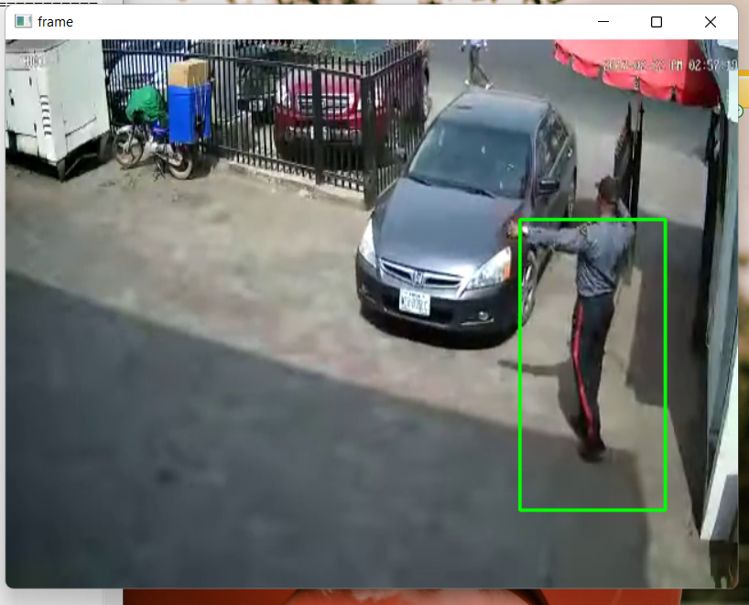
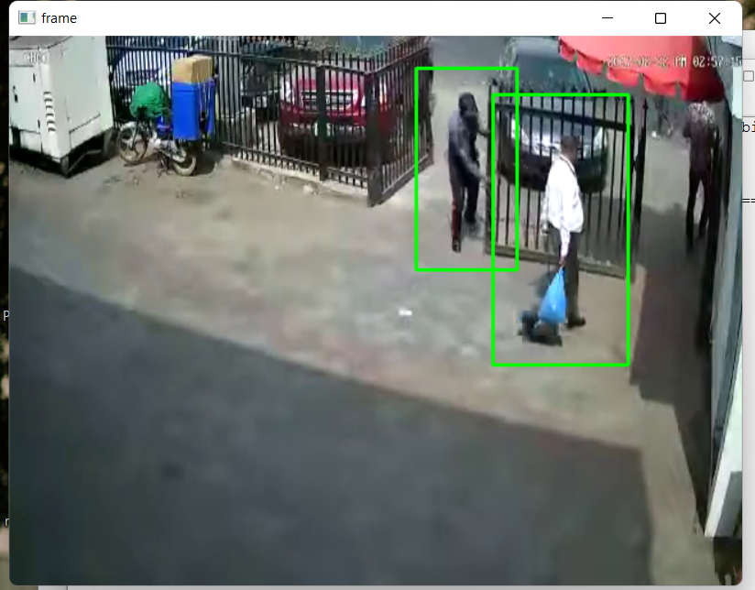
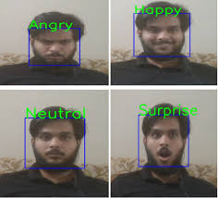
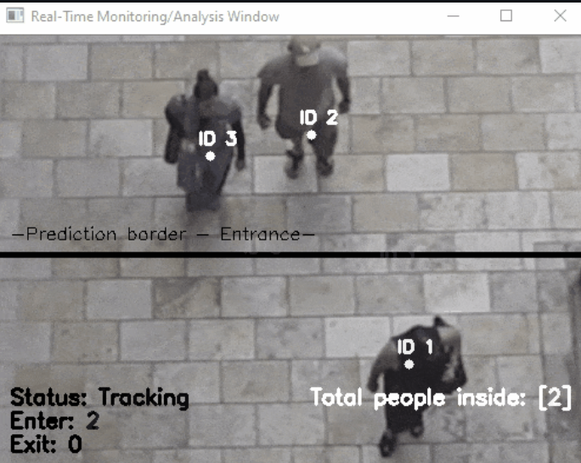
GitHub Repository Link & Relevant Links:
CCTV footages for model training :
https://www.kaggle.com/datasets/jubaerad/weapons-in-images-segmented-videos
https://www.kaggle.com/datasets/constantinwerner/human-detection-dataset
cv2.HOGDescriptor_getDefaultPeopleDetector() calls the pre-trained model for Human detection of OpenCV and then we will feed our support vector machine with it.
MODEL OUTPUT

Slide 10
Thank You
COLLEGE NAME:
St. JOSEPH’s INSTITUTE OF TECHNOLOGY, CHENNAI.
MENTOR: Mrs. K. Jaspin, M.E., (Ph.D).,
Assistant Professor/CSE
Team member names :
SANJITH KUMAR M (312421104145)
SETHULAKSHAMANAN SP (312421104150)
YOGESH SHAMLIN SHINANTH J S (312421104186)
VIGRAM K M (312421104181)

